Slide 1
CSC301
Observers, Adapters & Test Doubles

Slide 2
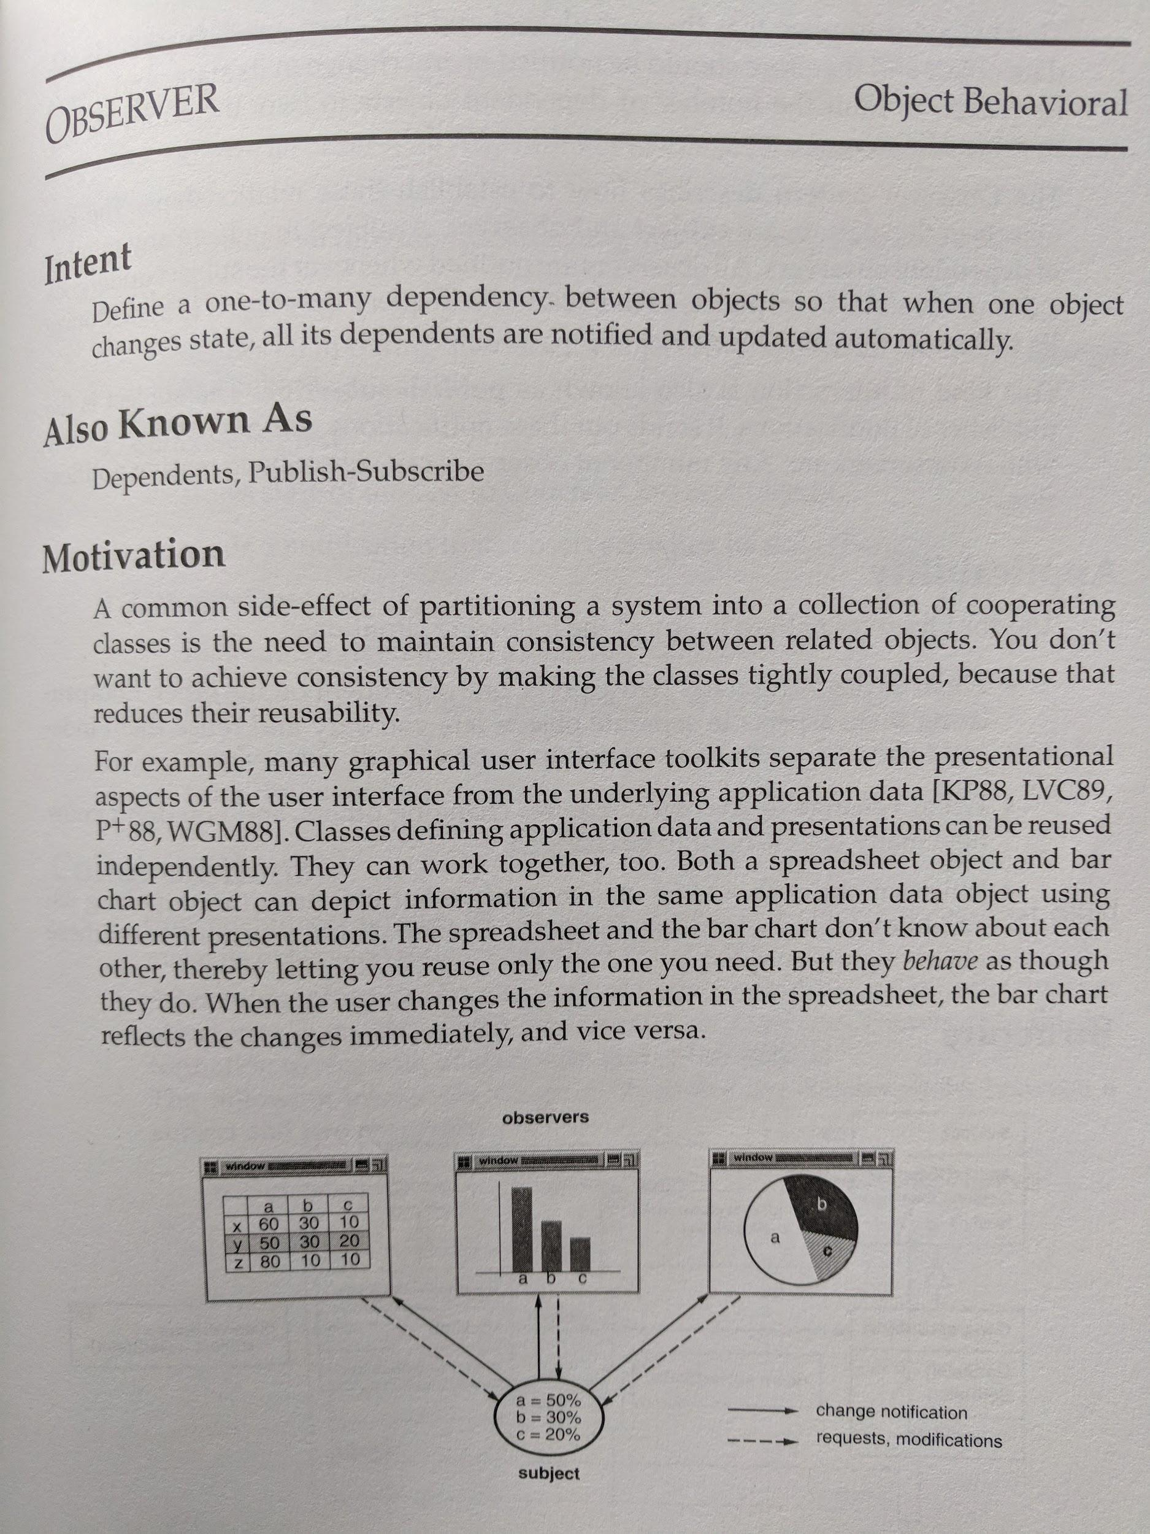
Observer/Observable Pattern
Common design pattern
Appeared in the Gang of Four book
Gamma, Helm, Johnson & Vlissides. “Design Patterns: Elements of Reusable Object-Oriented Software”, Addison-Wesley, 1994
Essentially, a collection of common problems and “recipes” for generic solutions

Slide 3
Terminology
A few names:
Observer-Observable
Listener
Publish-Subscribe
The concept is the same:
Whenever something happens to object A, object B gets notified and takes an action
The two objects care about interfaces (e.g., observer and observable), not concrete implementations

Slide 4
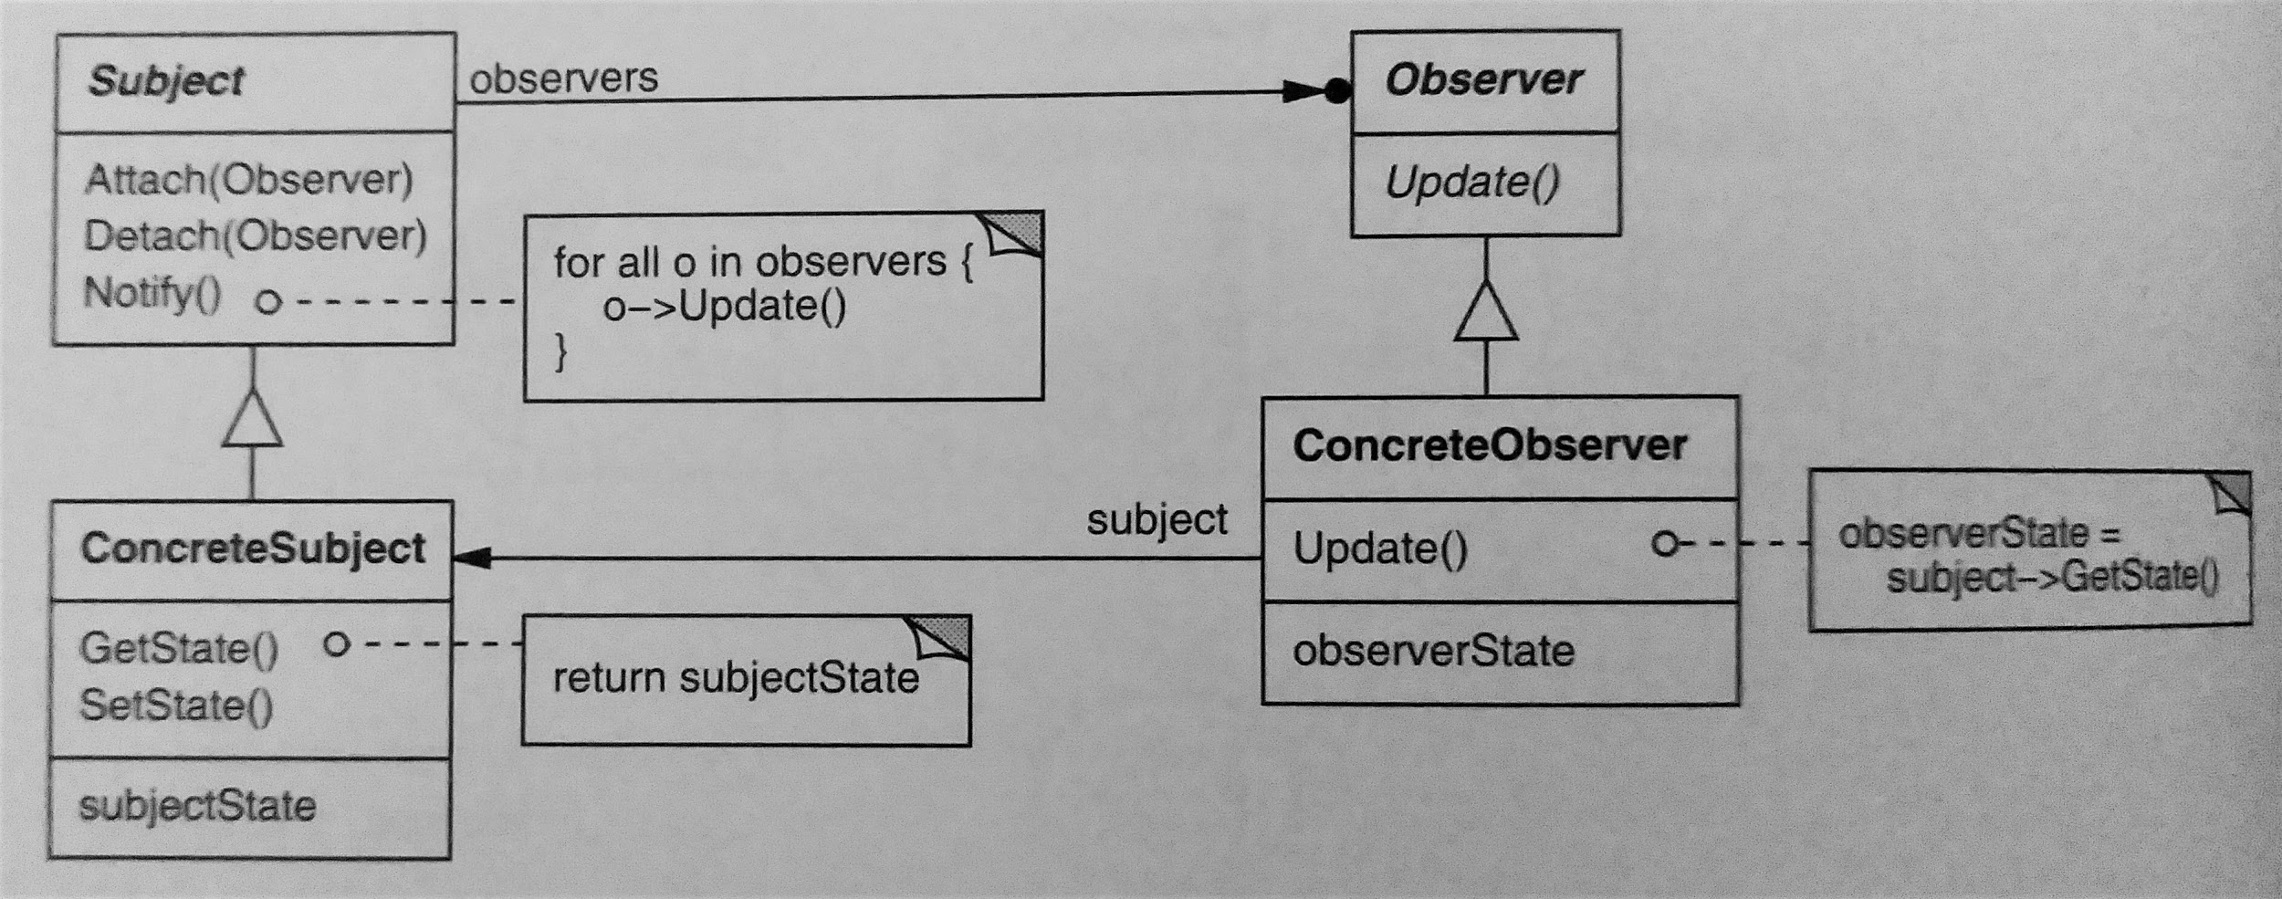
Observer Pattern Structure
[Design Patterns, GoF, p. 294]

Slide 5
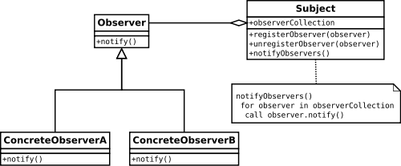
Observer Design Pattern
The diagram on Wikipedia uses a slightly different object modeling conventions, but uses the same general idea

Slide 6
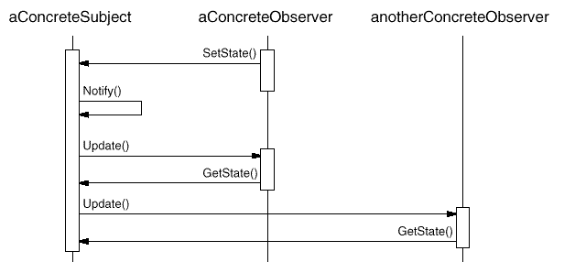
Yet another diagram from the GoF book ...
“setState” refers to some setter method of the subject..

Slide 7
Observer/Observable Pattern - Why?
Simple way to decouple modules
An observable doesn’t need to know much about its observers - As long as they implement some (usually simple) observer interface, they will get notified whenever something interesting happens
Fundamental building block in event-driven architecture
Common architecture where different components interact by raising (and listening to) events
Extremely common architecture for modern distributed systems
Another common example: Graphical User Interface, where a user’s action (such as a mouse-click) raises an event, which triggers various listeners. This is a standard way of decoupling GUI (presentation layer) from business logic.
Notes:
event can be defined as "a significant change in state”

Slide 8
Observer Design Pattern
Let’s go through an example.

Slide 9
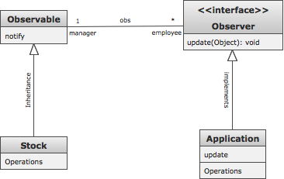
First implementation

Slide 10
Observer in Java
Issues with our first implementation:
What if Stock was already extending some class other than Observable?
Can only extend one class
The Observer interface requires us to cast the (Observable) argument (as Stock)
Another thing that can go wrong at runtime

Slide 11
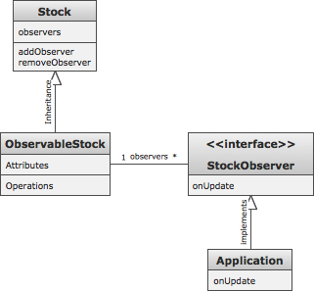
Roll own Observer/Observable

Slide 12
Observer in Java
Issues with our second implementation:
We need write more code (essentially, implementing what’s already implemented in Java’s built-in Observable class)
If you look at java.util.Observable, you’ll see that it’s not a trivial code.
Perhaps more complicated than you expected?
More code ⇒ More work
More code ⇒ Potentially more bugs

Slide 13
Observer in Java
An issue with observers:
Observables keep references to their observers ⇒ Observers don’t get garbage collected, until they are removed
Can lead to memory leaks
Exists in any language with automatic garbage collection
Known as the lapsed listener problem.
One solution is: Weak references

Slide 14
Back To Our Example
Let’s introduce a new “requirement”:
When the application observes a change in a stock, it would like to get the old price, as well as the new price

Slide 15
New Requirement
We can handle it in many ways:
Make the application store every price update in some sort of a database that it can query
Very heavy solution
Make the application store just the last price update it has seen for each stock
Better, but incohesive - The application has a new, unrelated responsibility
Create an adapter ...

Slide 16
The Adapter Design Pattern
Simple and intuitive
Object A outputs data in format 1
Object B expects input in format 2
Adapter connects between Object A and Object B
Takes input in format 1
Generates output in format 2
The concept should seem familiar

Slide 17
The Adapter Design Pattern
The Adapter pattern allows, for instance, to:
Convert the interface of a class to the one the client expects
Let classes with incompatible interfaces work together
Provide a new interface for a class
Solution:
Create a new class, Adapter, to convert the interface of the available class, Adaptee, to the required interface, Target, without changing it
Use Adapter to work with classes that don’t have the required interface
Clients will not know if they work with a Target directly or through an Adapter with a class without the Target interface

Slide 18
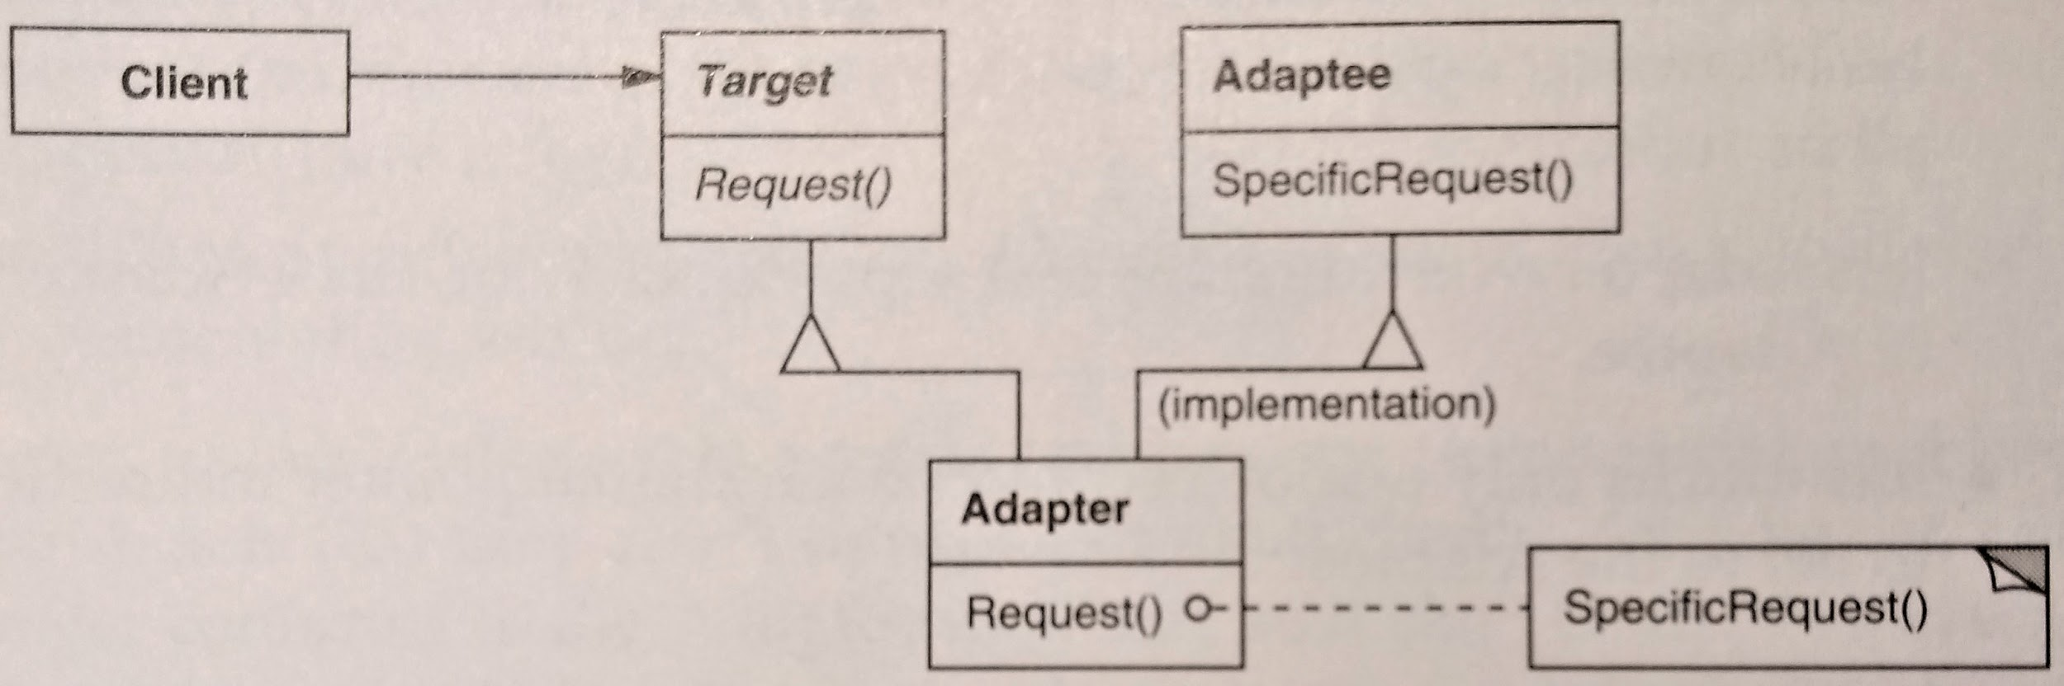
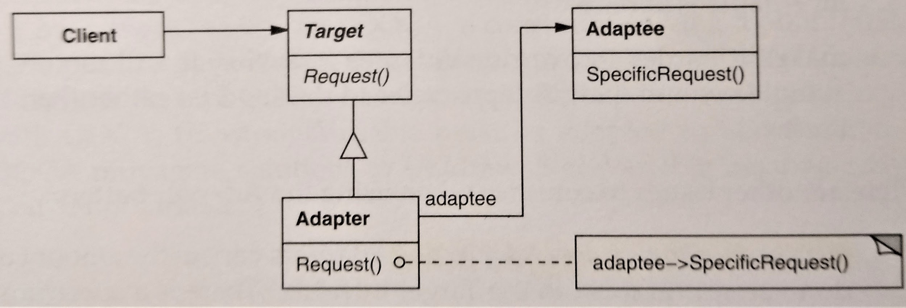
Implementing The Adapter Pattern
Inheritance
vs.
Composition
Structure
A class adapter uses multiple inheritance to adapt one interface to another:
An object adapter relies on object composition:
[Design Patterns, GoF, p. 141]

Slide 19
The Adapter Design Pattern
Cleans up your code
Helps decouple modules and separate concerns
No need to worry about adapting to other modules’ expectations
Sometimes it’s the only solution
E.g.: Adapting between components you cannot change (you don’t have the source code)
Especially when combining frameworks
Original GoF example combined a font framework (for text) with a drawing program framework
Notes:
coupling is the degree of interdependence between software modules
cohesion refers to the degree to which the elements inside a module belong together. In one sense, it is a measure of the strength of relationship between the methods and data of a class and some unifying purpose or concept served by that class. In another sense, it is a measure of the strength of relationship between the class’s methods and data themselves.

Slide 20
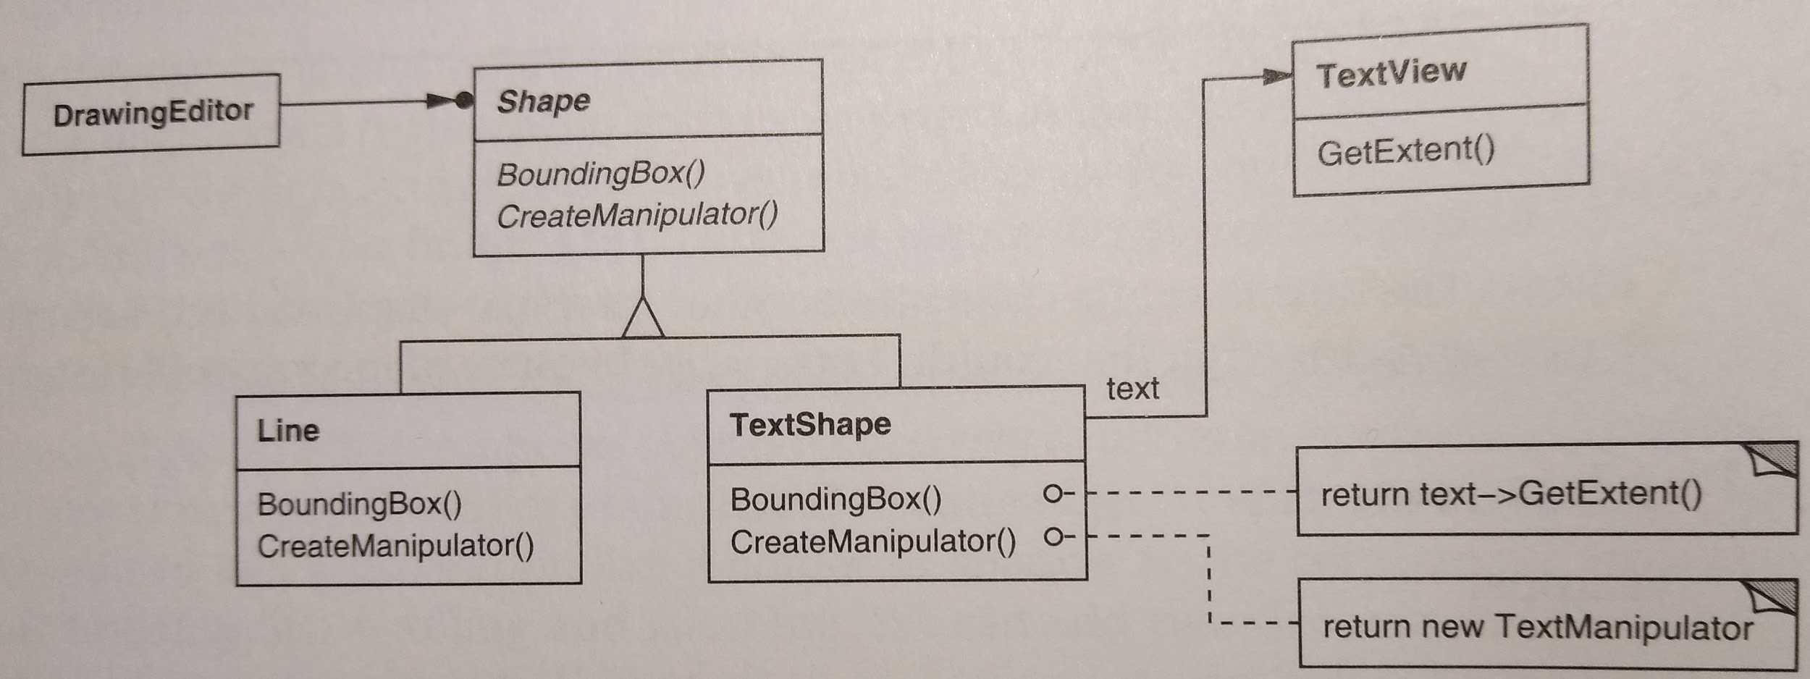
Adapter to Combine Frameworks
TextView part of font manager framework
TextShape adapts TextView to drawing editor framework
[Design Patterns, GoF, p. 140]

Slide 21
Observers & Adapters, Summary
Extremely common patterns
Tools for “gluing stuff together”
Help us obtain
Cleaner code
Cohesive classes
Decoupled system

Slide 22
Test Doubles - Design Patterns For Testing
Term coined by Gerard Meszaros in the book “xUnit Test Patterns”, Addison-Wesley, 2007
Various design patterns for objects used for testing
The idea is simple: During testing, replace an object with a test double
An object that “looks the same” (i.e., implements the same interface(s) )
But gives us more inspection/monitoring capabilities

Slide 23
Test Doubles
Test double is a general name for various patterns:
Dummy - No implementation, passed around, but not used - usually just to fill parameter requirements
Fake - has a working implementation, but not suitable for production use (e.g., in-memory test database)
Stub - Somewhat similar to Fake, but only behaviour needed for testing is implemented (i.e., has no logic, returns pre-programmed answers for testing)
Spy - A stub that also records information about how it was called
Mock - A spy that expects to be used a certain way, can be used to test object interactions
E.g., can throw an exception if it receives a call it doesn’t expect and is checked during verification to ensure it got all the calls it was expecting

Slide 24
Test Doubles
There is a very interesting article about mocks vs. stubs
With good arguments for and against each approach
More than a subtle difference in implementation details, it’s a different testing philosophy!
In the “classic approach” (using stubs), we validate the state of an object. That is, we call method X on object A, and then inspect A to make sure it looks as we expect
In the “mockist approach” (using mocks), we validate the object behaviour. That is, we call method X on object A, and verify that A made the expected calls (i.e., sent the expected messages) to all of its collaborators.

Slide 25
Another Code Example
Let’s see another code example that applies the observer pattern
It is “the classic” use case of the observer/observable pattern - Separating User Interface from “the engine” of your application
It also uses a test double to test the observable functionality (i.e., verify that the observable is notifying all of its observers properly)

Slide 26
MVC
Using observers and/or adapter to separate (decouple) UI and backend is a very common technique
It evolved into a pattern/paradigm, called MVC
MVC stands for Model-View-Controller
Divide an application into three pieces:
Model - Our application’s representation of the real-world in problem domain-specific terms; directly manages data, logic, etc.
View - Any representation of the model, what users interact with
Controller - Connects the model and the view
Let’s see an example of MVC

